Slide 1
HOW TO FILL OUT YOUR PROGRESS REPORT

Slide 2
Where To Find Progress Report
Each Fall and Spring semester you receive an email from Honors@wpunj.edu with a link to the progress report form.
The Fall email is usually around November 1 and the Spring email is usually around April 1.
You usually have 10-12 days to complete the form.

Slide 3
Before You Begin
Important things to note:
You should list only track courses
Courses that are required for your track
You need to write one or two sentences regarding your progress in your track:
Specify what course you have completed
What stage you are in toward the completion of your thesis
If you have not taken track courses you need to explain what you have done to progress in the track

Slide 4
Filling Out the Form
If you have previously completed an online progress report, the courses you submitted will appear at the bottom box.

Slide 5
Filling Out the Form
Select courses/ For multiple course selection hold down the control key while making your selection.

Slide 6
Filling Out the Form
Enter your anticipated Graduation day
Must be the following format mm/dd/yyyy otherwise you will get an error message

Slide 7
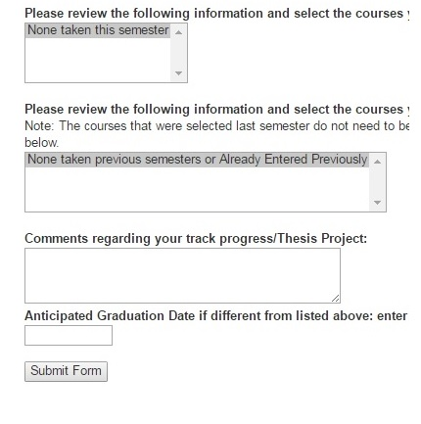
Submit Your Form
Finally submit your form by clicking the submit button

Slide 8
Having Problems? Check the Following
Verify that you made selections in both boxes
Make sure the date format is correct
If you are using anything Apple, try filling the form from another device
If you cannot resolve the problem, send an email to honors@wpunj.edu

